Slide 1
I-Schedule
Meeting Scheduling made easy!

Slide 2

Purpose
I-Schedule is a meeting scheduler that enables a user to send a query that asks other users for their availability to attend a meeting. Those “member” users confirm their availability out of a list of times chosen by the “host” user. The “host” user is given the responses to their query and can determine when to start the meeting based on that feedback.
Ariful

Slide 3



Technical Platforms
Flutter based mobile and web applications
FireStore database to store user info and created/pending meetings
Google/iOS/Webex Calendar Integration
Dylan

Slide 4
Storyboard #1
Registration and
Meeting Accepting
Hunter

Slide 5
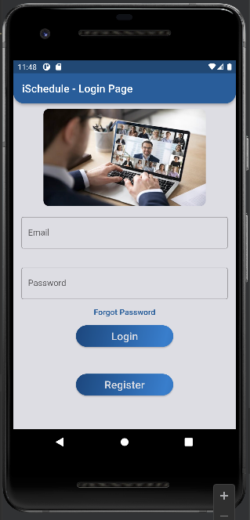
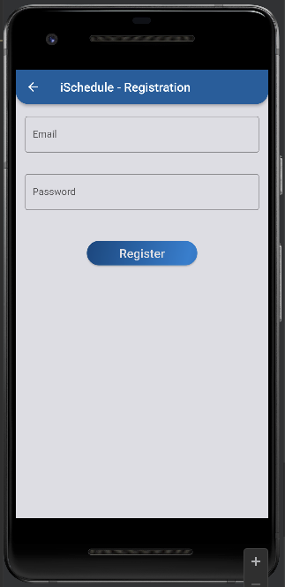
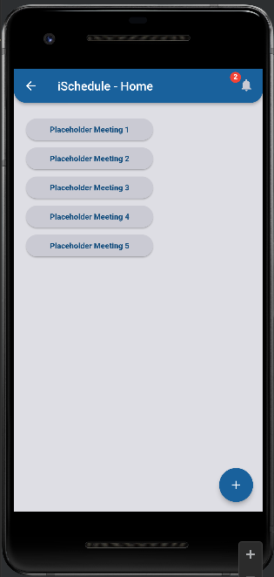
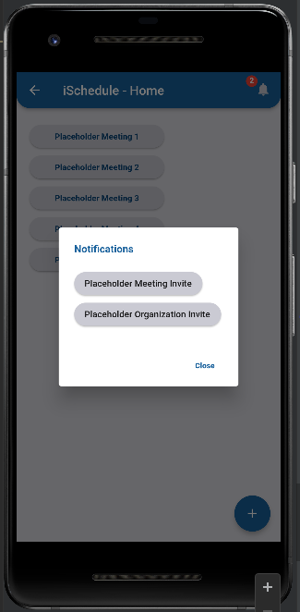
User begins by signing in with their login information.
If the user doesn’t have an account, they can register by clicking on the Register button on the login page.
User can enter their email and password to register.
In their homepage, on the top right will be a bell. The users can click this bell to see a list of current meeting invitations.
In this popup, users would be able to select the invitations to attend. Once the meeting invite with a time is selected, the meeting will be shown in the user’s homepage.

Slide 6
Storyboard #2
Meeting Creation
Amisha

Slide 7
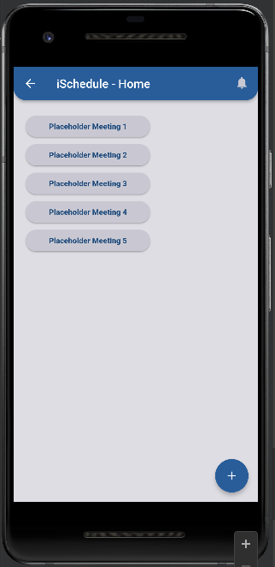
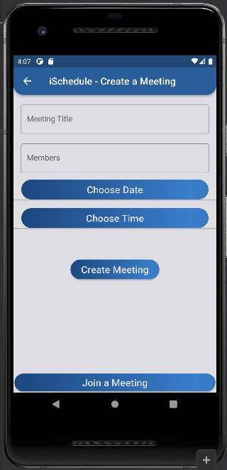
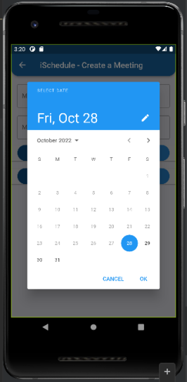
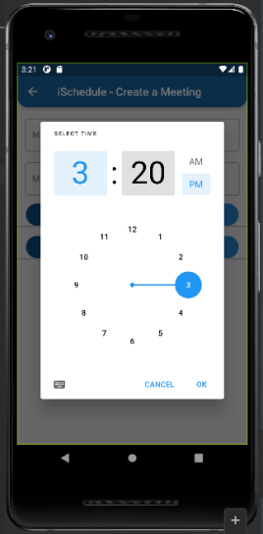
User begins by signing in with their login information, which takes them to their homepage
On the homepage, the user can see their list of scheduled meetings. If they want add a new meeting, they can click/tap on the Plus button on the bottom right of their screen.
Then, in the Create Meeting Page, the user/host chooses the date and their available times for that date and tap the Create Meeting button, which would send the meeting invitee the host’s available times.

Slide 8
Thank You!

